Slide 1

US DOL TAACCCT Round 2 Grant
Starts: October 1, 2012
Ends: September 30, 2016

Slide 2
Trade Adjustment Assistance Community College and Career Training
What is a DOL TAACCCT Round II Grant?
  Grants are the second installment ($500 million) of a $2 billion, four-year initiative
  Funds to expand and improve delivery of education and career training programs- completed in two years or less
  Suited for workers who are eligible for training under the TAA for Workers program
  Prepare program participants for employment in high-wage, high-skill occupations

Slide 3
Need for the Biosciences Consortium
No national program for the acquisition of an industry-recognized credential associated with core skills
Public workforce systems are not geared toward matching skills and preparation with previous training and industry experience

Slide 4
What are the Goals?
Improve preparation for workplace training: recruitment testing, aptitude assessment, redesign courses, improve retention and outreach
Introduce portable industry recognized credentials into training: core bioscience skills standards foundation
Accelerate completion time in programs through:
    improved prior learning assessment, removal of institutional barriers
    technology enhanced instructional materials - use NTER platform
4. Build CC capacity for education that meets employer needs: add infrastructure, build Capstone and internship programs

Slide 5
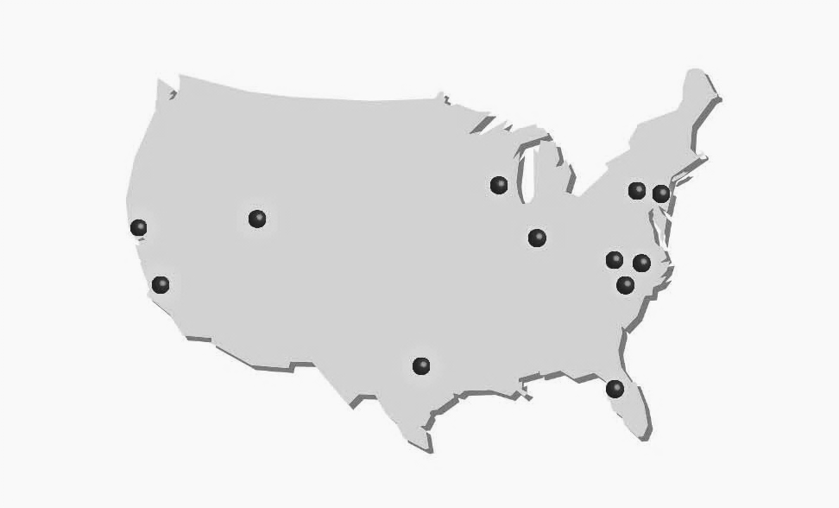
Grant Value: $ 14, 998, 474
City College of San Francisco
Madison Area Tech
Montgomery
Bucks
Ivy Tech
Salt Lake
Forsyth Tech
Alamance
LA Valley
Rowan-Cabarrus
Austin
St Petersburg
Hubs by color
Lab Skills
Medical Devices
Biomanufacturing
Learning
Recipients : 12 colleges, 8 states

Slide 8
Moving forward with Technician Training
Over 25 new courses/credentials will be developed in the Biosciences
Focused and accessible online learning opportunities with game like applications for training bioscience workers
Revised skills standards will be available for Biomanufacturing and Lab Skills
New skill standards will be created in Biomedical Devices
Core harmonized bioscience skills standards will be created

Slide 10
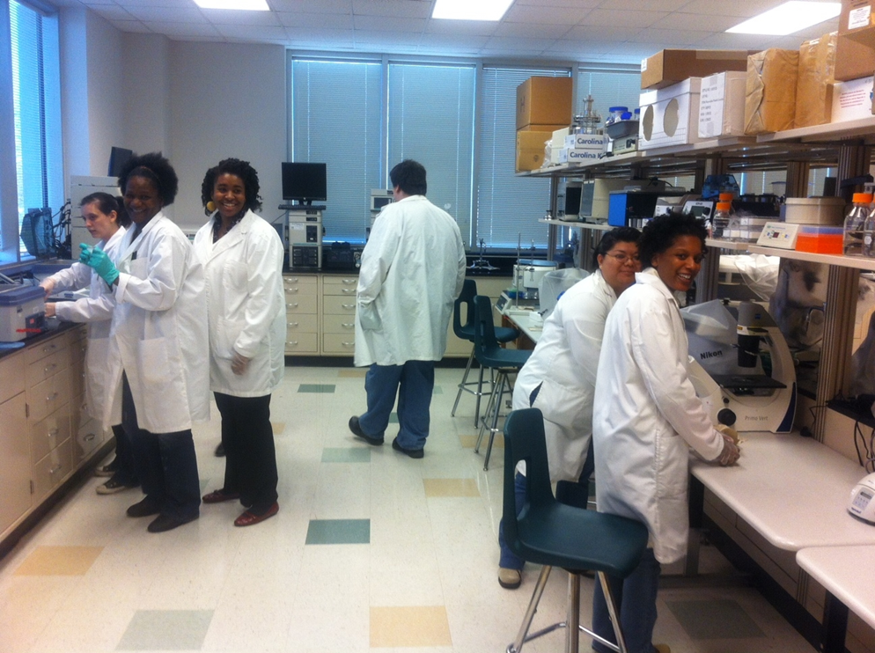
What is in it for Companies?
The improved assessment of potential employees from a workforce prospective
An increased source of qualified employees
An Industry Recognized harmonized core of skill standards & credentials

